Slide 1
Implementing Spiking Neural Networks on Lattice FPGA

Slide 2
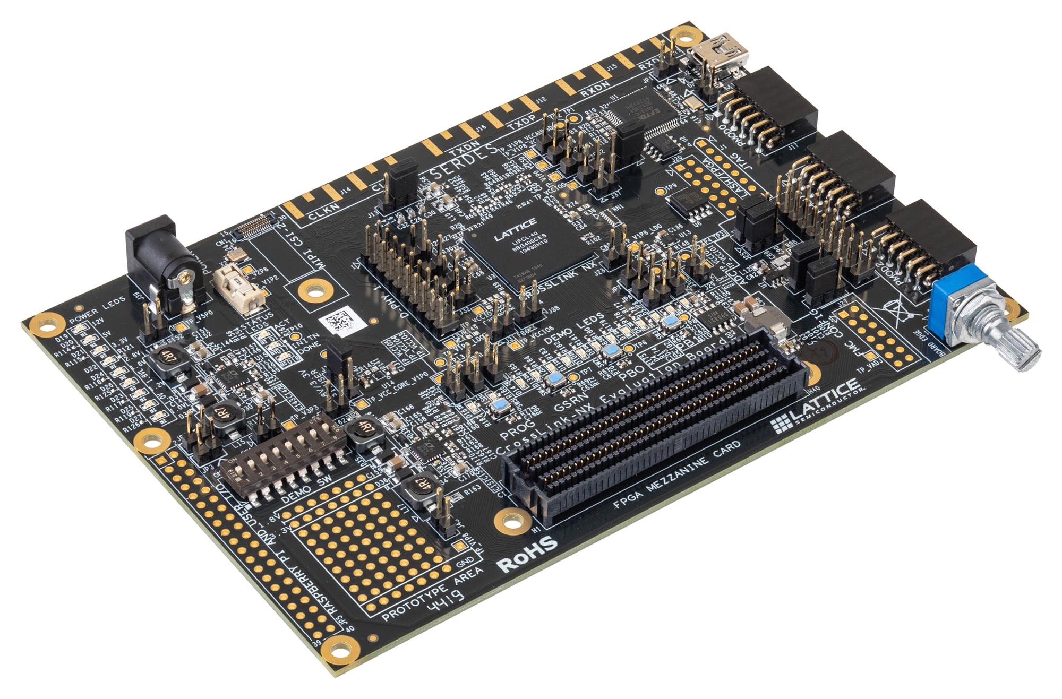
Main specs of the LIFCL-40-9BG400C FPGA on the LIFCL-40-ENV Development board
Logic capacity: 39k logic cells
Embedded block RAM: 1512 Kbit
LRAM: 1024 Kbit

Slide 3
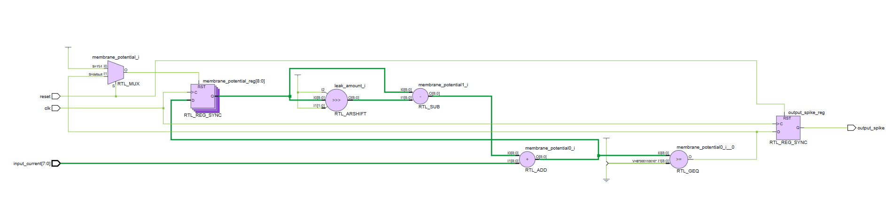
A Simple Digital Logic Design for LIF Networks
To estimate the size of the network the FPGA is capable of. We use a simple implementation of a LIF Neuron with shift-based leak so it does not require hardware multipliers.

Slide 4
Resource estimates for a single LIF Neuron
Resource | Estimated amount
Flip-flops | 10
LUT4s / logic cells | 20–27
Carry chains | Approximately two 9-bit chains
DSP multipliers | 0
Block RAM | 0
PLLs | 0

Slide 5
A rough estimate of the maximum size for a simple Feed-forward LIF Neural Network
Estimated LUT4s required for a 3-layer feed-forward, fully parallel, dense Network
Network(in, hidden, out) | Connections | Estimated LUT4s | Approx. usage
16–32–10 | 832 | ≈10,000 | 31%
32–32–10 | 1,344 | ≈15,000 | 46%
16–64–10 | 1,664 | ≈19,000 | 58%
48–32–10 | 1,856 | ≈20,000 | 62%
32–48–10 | 2,016 | ≈22,100 | 68%
128–16–10 | 2,208 | ≈23,200 | 71%
64–28–10 | 2,072 | ≈22,200 | 68%
64–30–10 | 2,220 | ≈23,700 | 73%
64–32–10 | 2,368 | ≈25,200 | 78%
32–64–10 | 2,688 | ≈29,200 | 90%

